Slide 1
ILIAS
http://ilias.uni.lu
Interdisciplinary Laboratory for Intelligent and Adaptive Systems
Prof. Dr. Pascal Bouvry
September 2016

Slide 2
We investigate the theoretical algorithmic realisations of:
Intelligent systems:
performing complex problem solving and decision making tasks with a high degree of autonomy.
Adaptive systems:
exploiting learning and flexible computing models to deal with opaque and dynamic contexts.
Keywords: Artificial Intelligence, Bio-Inspired Computing, Decision Systems, Information Theory, Knowledge Representation, Multi-Agent Systems, Parallel Computing, Reasoning and Logic, Text and Data Mining, Social Computing.
Currently, ILIAS has more than 40 researchers (Profs, PostDocs, PhDs)

Slide 3

We have project co-operations with
the Interdisciplinary Centres:
SnT, LCSB
other UL Departments:
LDE – Laboratoire de Droit Economique (Dept. of Law)
LSF – Luxembourg School of Finance (Dept. of Finance)
Dept. of Mathematics
Dica-Lab (Faculty of Language and Literature, Humanities, Arts and Educational Sciences)
other CSC Labs: ComSys, LACS, LASSY and the LIST
Moreover, we have active research contacts with numerous universities and institutions in the Greater Region and around the world.
Thanks also to the for their financial support.
http://ilias.uni.lu

Slide 4
Research Groups at ILIAS
 | Decision Systems | (Prof. Dr. R. Bisdorff)
 | Optimization & Parallel Computing | (Prof. Dr. P. Bouvry)
 | Individual & Collective Reasoning | (Prof. Dr. L. v. d. Torre)
 | Information Mining & Knowledge Discovery Information Theory & Stochastic Inference | (Prof. Dr. C. Schommer) (Prof. Dr. U. Sorger)
Visiting Professor
Prof. Dr. Dov Gabbay
Augustus De Morgan Professor of Logic, Kings College London, UK.
http://ilias.uni.lu

Slide 5
Research at ILIAS
More than 370 research papers (conference, journal, books) have been published between 2012 and 2015.
We are currently working in 10 research projects
Internal, National and European (H2020 and European Defense Agency)
The ILIAS group is a member of the Benelux Artificial Intelligence Group (BNAIC).
Prof. van der Torre is a member of the Executive Committee for ERCIM* (representing Luxembourg).
Between 2012 and 2015, several ILIAS professors have been invited as speaker at an international conference.
Regularly, 5 – 6 PhD candidates and 5 – 10 Master students successfully defend their thesis at ILIAS, respectively.
We regularly organise Artificial Intelligence Seminar Series with international speakers.
We contribute to the Luxembourg society by participating student fairs, Leonardo Summer School, Luxembourg Researchers Night, and others.
We are members of numerous Conference Program Committees organised by IEEE, ACM, CogSci, and others.
* ERCIM = European Research Consortium for Informatics and Mathematics. http://www.ercim.eu/
http://ilias.uni.lu

Slide 6
We contribute to academic programs:
Doctoral School in Computer Science and Computer Engineering
Master of Science in Information and Computer Science
Bachelor of Engineering in Informatics
Bachelor in Life Sciences
Certificate Smart ICT for Business Innovation
Internal Organisation:
ILIAS PhD Candidate Colloquium
ILIAS Seminars
ILIAS RoboLab
ILIAS Days (to come)
http://ilias.uni.lu

Slide 7



Certificate - Smart ICT for Business Innovation
Certificate proposed in 2015 by
University of Luxembourg and its partner,
the Institut luxembourgeois de la normalisation, de l'accréditation, de la sécurité et qualité des produits et services (ILNAS)
Train in a year's time, people who want to - further - develop Smart ICT skills and maybe embrace new career opportunities in positions like
Digital Strategy Consultant, Smart ICT Consultant, Innovation Manager, Standards Manager, Head of Innovation, Head of Digital Strategy or Entrepreneur (start-up company).
Enhance the skills of ICT professionals and contribute to reinforce the position of Luxembourg in the field of Smart ICT

Slide 8
ILIAS Highlights
Publications – Authored books
D. Gabbay et al. Handbook of Deontic Logic and Normative Systems Vol.1. College Publications, 2013.
B. Dorronsoro et al. Evolutionary Algorithms for Mobile Ad Hoc Networks. Wiley, 2014.
R. Bisdorff et al. Evaluation and Decision Models with Multiple Criteria: Case studies, International Handbook on Information Systems, Springer, 2015

Slide 9

ILIAS Highlights
Events
Organisation of the IEEE Cloudnet 2014 conference with 250 attendants
Upcoming:
IEEE CloudCom 2016 - 8th IEEE International Conference on Cloud Computing Technology and Science – December 2016
5th international "Algorithmic Decision Theory" Conference - October 2017

Slide 10
ILIAS Highlights
Scientific networks/awards
Participation in the Erasmus+ program LAST-JD (Joint International Doctoral Degree in Law, Science and Technology)
Pascal Bouvry and D. Kliazovich received the IEEE Outstanding Leadership Award
Leon van der Torre was appointed as an EurAi (formerly ECCAI) fellow on Oct. 10, 2015
Active participation of R. Bisdorff in the CNRS founded international research group (GDRI) on "Algorithmic Decision Theory" also supported by the FNRS (Belgium) and the FNR (Luxembourg)

Slide 11

ILIAS Highlights
Other achievements
Spin-off business project aimed at robotics for autistic children based on a PhD thesis (ProCrob) and launched through FNR's Proof-of-Concept Scheme.

Slide 12
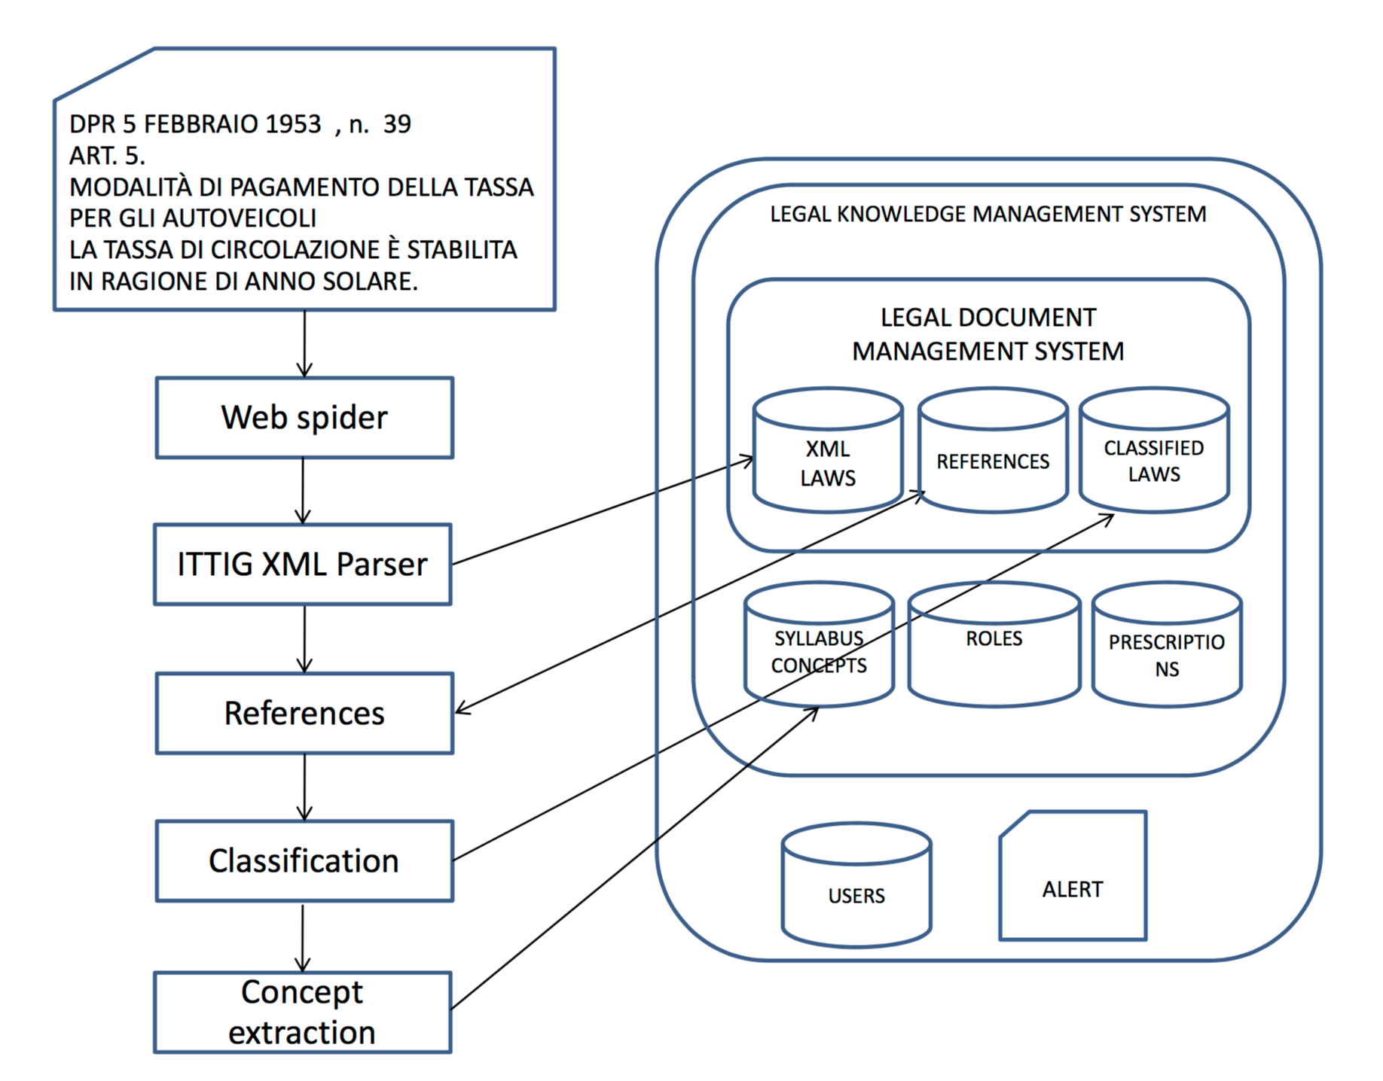
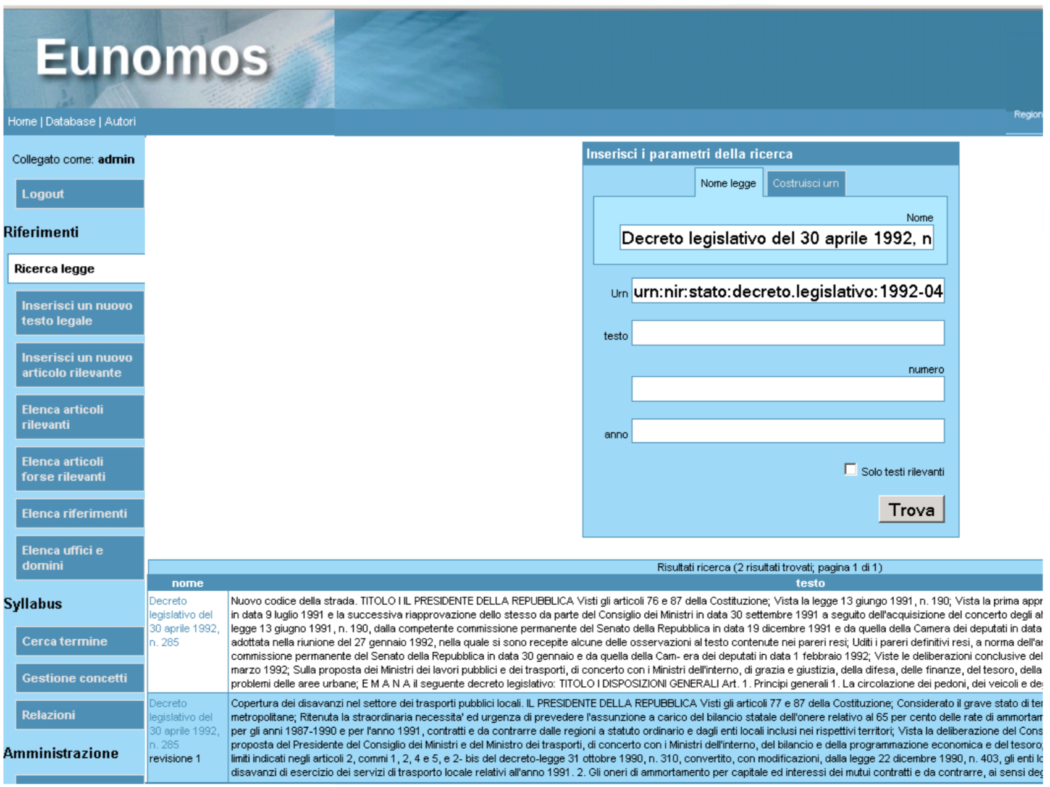
ILIAS Science Impact
Our work legal informatics together with the University of Turin has led to
EUNOMOS - a legal document management system

Slide 13
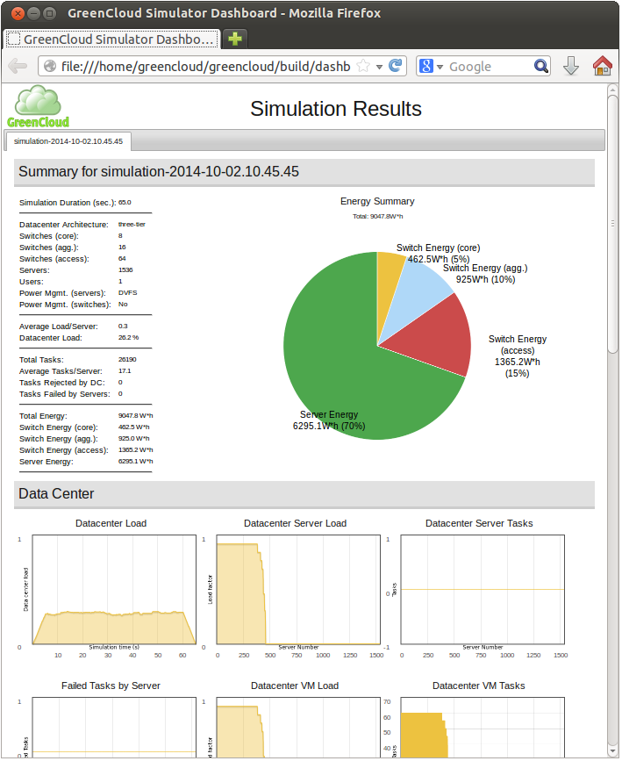

ILIAS Science Impact
Our research in the field of green computing has led to the development of
GreenCloud – a state-of-the-art open-source Cloud simulator
Download at: http://greencloud.gforge.uni.lu
Available as source code or preinstalled virtual machine
1018 visits and 223 downloads monthly

Slide 14

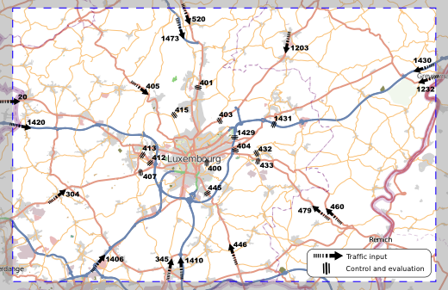
ILIAS Science Impact
Our work on vehicular networks has led to the development of
VehILux - a mobility model of vehicle traffic in Lux based on real traffic data
OVNIS - one of the first vehicular network simulators coupling a network and a traffic simulator in a bidirectional way

Slide 15
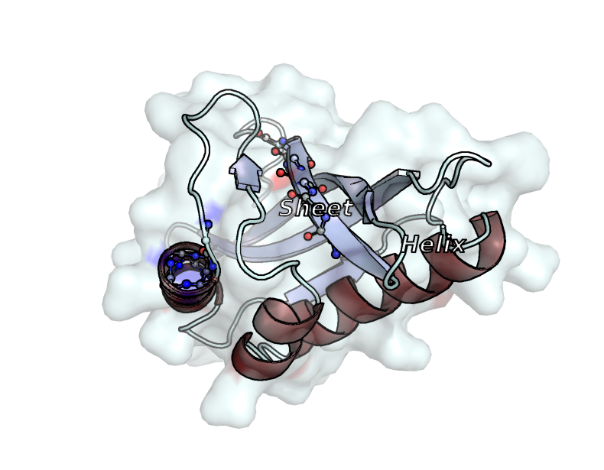
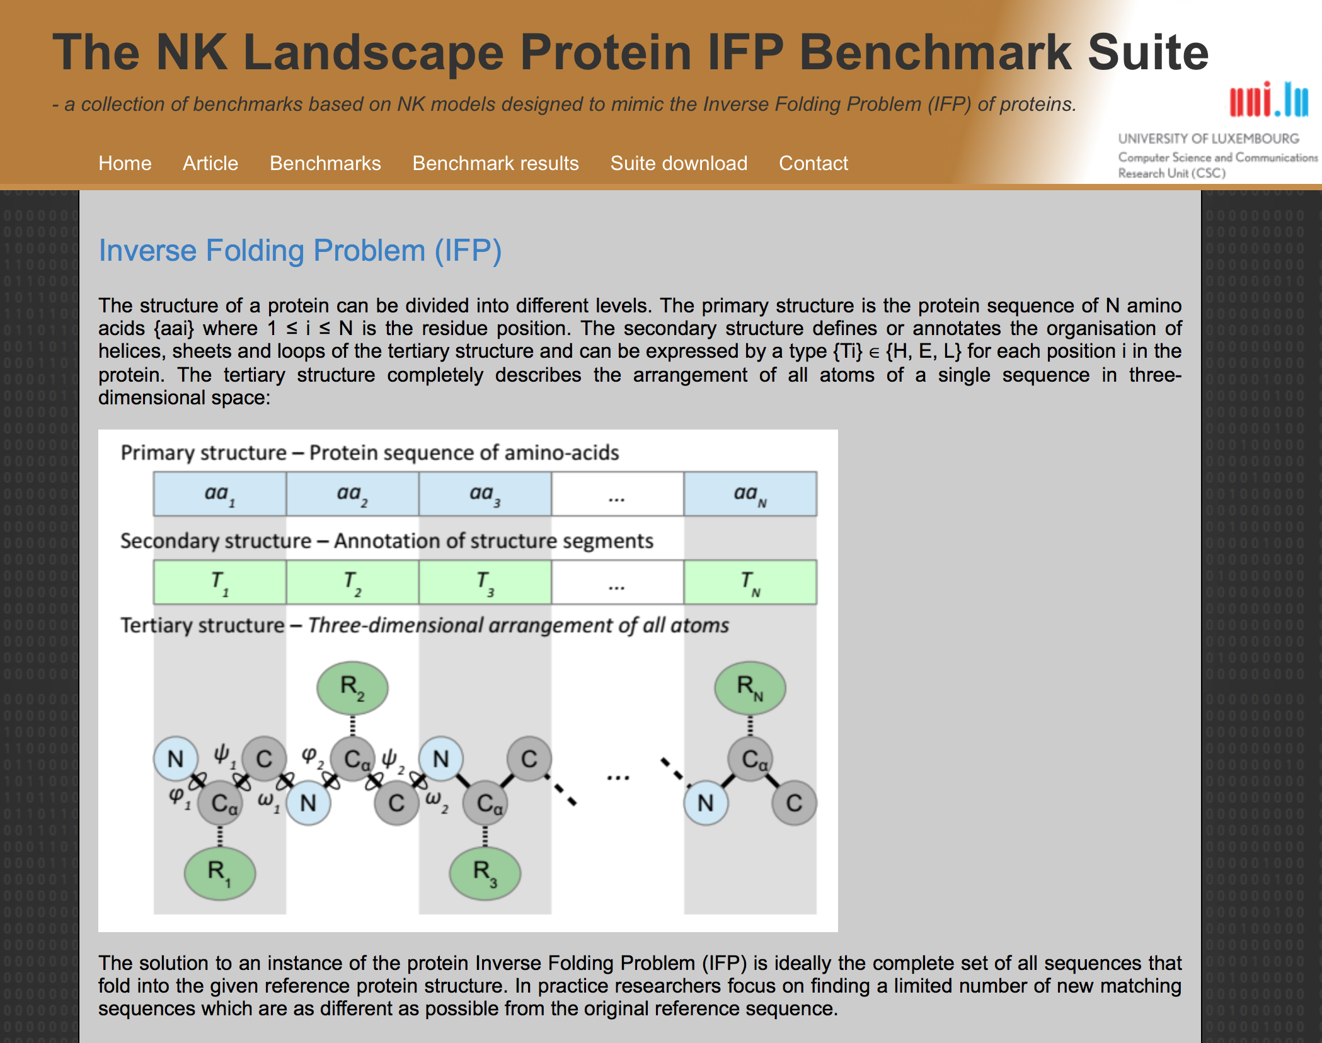
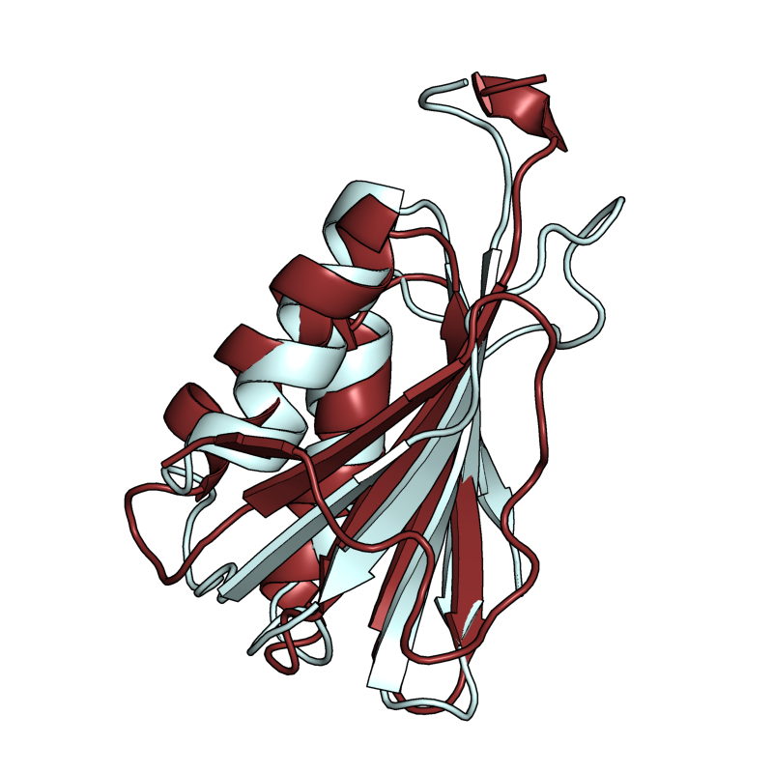
ILIAS Science Impact
Our work on bioinformatics problems optimization has led to
the development of novel optimization benchmarks: NK Landscape Protein IFP Benchmark Suite

Slide 16

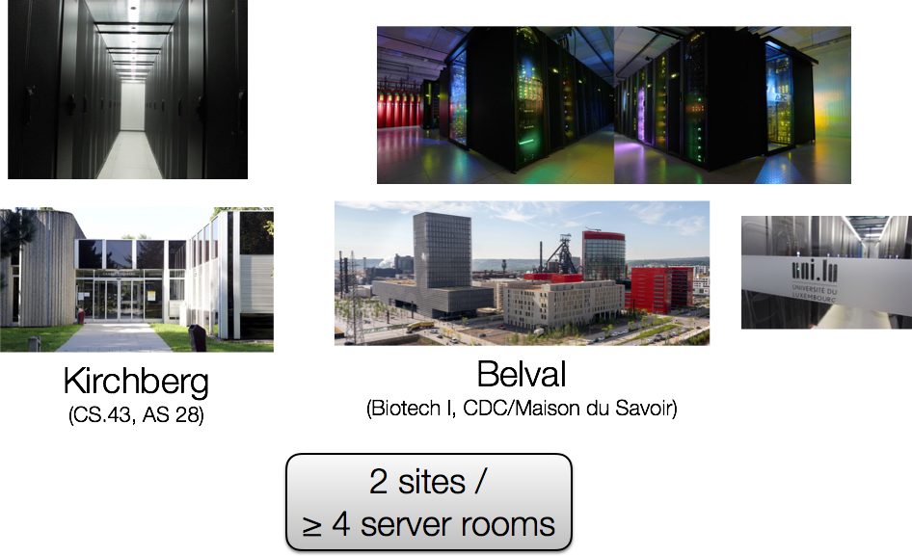
HPC - High Performance Computing Sites

Slide 17
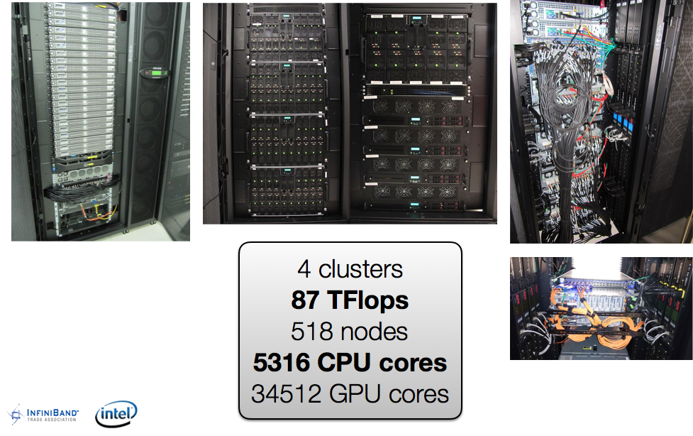
HPC - High Performance Computing Computing Capacity

Slide 18
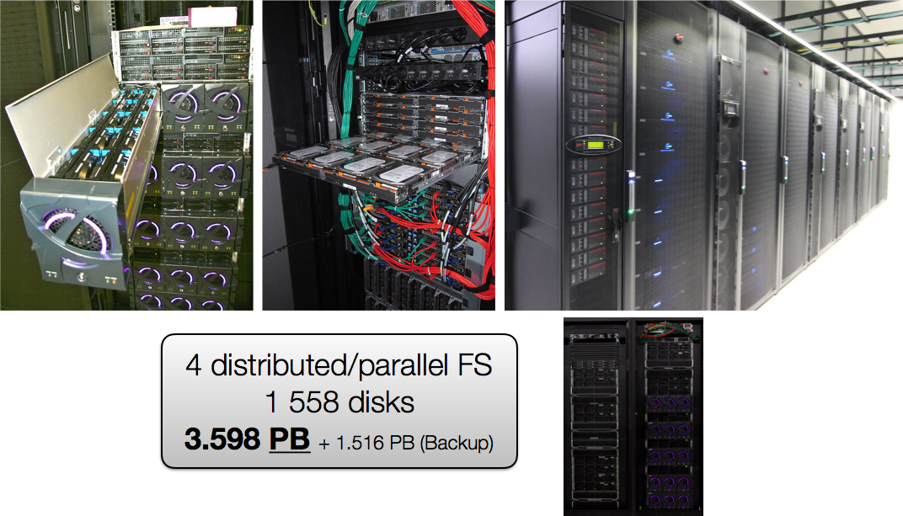
HPC - High Performance Computing Storage Capacity

